Slide 1

Squid Proxy

Slide 2
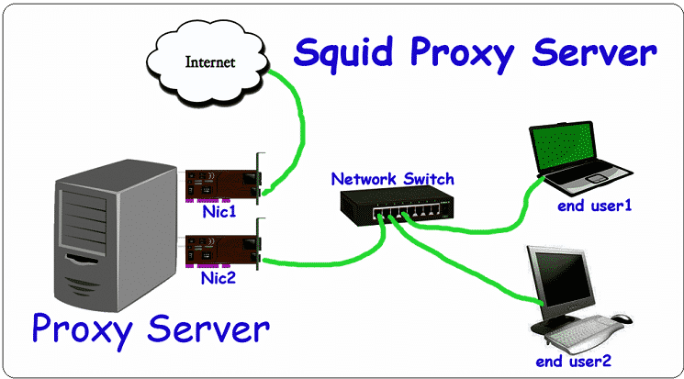
Squid proxy design

Slide 3
Squid Installation
Step 1 – Install Squid
#yum install squid
Step 2 – Setup SQUID Service
# vi /etc/squid/squid.conf
update the config as below
http_port 8080
After making changing let’s restart Squid service to reload the configuration changes
#systemctl start squid
# systemctl enable squid

Slide 4
Config - Continued
Step 3 – Block Specific Website with Squid
Let’s start with the additional configuration like blocking any website using squid proxy server. Add below rules to block specific website before any allow all rules. Below example will block yahoo.com and www.rediff.com.
acl blocksite1 dstdomain yahoo.com
acl blocksite2 dstdomain www.rediff.com
http_access deny blocksite1
http_access deny blocksite2

Slide 5
Config - Continued
Step 4 – Block Specific Keyword with Squid
Add below rules to block specific website before any allow all rules. Below example will block all pages having keyword yahoo or Gmail.
acl blockkeyword1 url_regex yahoo acl blockkeyword2 url_regex gmail http_access deny blockkeyword1 http_access deny blockkeyword2

Slide 6
Testing
In linux client machine:
# export http_proxy=http://${PROXY_FQDN}:8080
# curl -v http://google.com | head -1
On windows machine:
In browser go to proxy settings and set the proxy as the server we configured and port number

